Slide 1
► WHAT TO EXPECT IN A PROGRAM REVIEW
ENGAGEMENT
DRAFTING
PUBLICATION
PRE-REVIEW
FOLLOW-UP ENGAGEMENT
FIELDWORK
FOLLOW-UP REVIEW
FOLLOW-UP PUBLICATION
START
1
2
3
4
5
6
7
8
FINISH
Compliance Division
Notes:
DAN

Slide 2

► WHAT TO EXPECT IN A PROGRAM REVIEW
ENGAGEMENT
DRAFTING
PUBLICATION
1
PRE-REVIEW
FOLLOW-UP ENGAGEMENT
FIELDWORK
FOLLOW-UP REVIEW
FOLLOW-UP PUBLICATION
ENGAGEMENT
START
1
2
3
4
5
6
7
8
FINISH
Engagement email
Request for materials
Questionnaire (Inspection)
Sample Inspection report (Inspection)
Compliance Division
Notes:
ALICIA

Slide 3
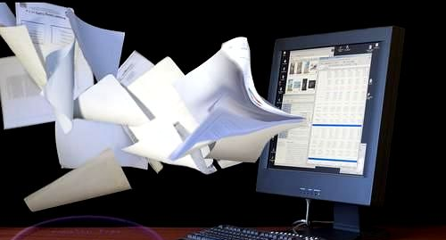
► WHAT TO EXPECT IN A PROGRAM REVIEW
ENGAGEMENT
DRAFTING
PUBLICATION
2
PRE-REVIEW
FOLLOW-UP ENGAGEMENT
FIELDWORK
FOLLOW-UP REVIEW
FOLLOW-UP PUBLICATION
PRE-REVIEW
START
1
2
3
4
5
6
7
8
FINISH
Assess materials for compliance
Identify program strengths and vulnerabilities
Record compliant and non-compliant program areas
Select sample of financial disclosures
Generate and send follow-up questions
Coordinate fieldwork dates
Compliance Division
Notes:
ALICIA

Slide 4

► WHAT TO EXPECT IN A PROGRAM REVIEW
3
ENGAGEMENT
DRAFTING
PUBLICATION
PRE-REVIEW
FOLLOW-UP ENGAGEMENT
FIELDWORK
FOLLOW-UP REVIEW
FOLLOW-UP PUBLICATION
FIELDWORK
START
1
2
3
4
5
6
7
8
FINISH
Entrance conference
Review selected financial disclosure sample
Observe storage areas and proper retention
Interview ethics officials (and other agency personnel as necessary, e.g., HR, IG)
Compliance Division
Notes:
J

Slide 5

► WHAT TO EXPECT IN A PROGRAM REVIEW
ENGAGEMENT
DRAFTING
PUBLICATION
PRE-REVIEW
4
FOLLOW-UP ENGAGEMENT
FIELDWORK
FOLLOW-UP REVIEW
FOLLOW-UP PUBLICATION
DRAFTING
START
1
2
3
4
5
6
7
8
FINISH
Note transcription
Prepare rough draft
Resolve discrepancies
Prepare discussion draft
Index and reference work papers
Initial agency comment
Prepare final draft
Formal agency comments
Compliance Division
Notes:
J

Slide 6
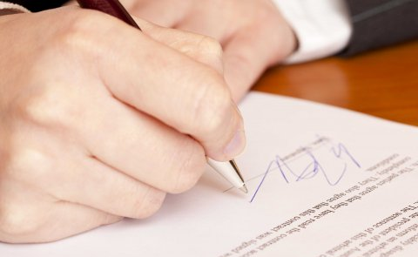
► WHAT TO EXPECT IN A PROGRAM REVIEW
ENGAGEMENT
DRAFTING
PUBLICATION
PRE-REVIEW
5
FOLLOW-UP ENGAGEMENT
FIELDWORK
FOLLOW-UP REVIEW
FOLLOW-UP PUBLICATION
PUBLICATION
START
1
2
3
4
5
6
7
8
FINISH
Report printing, signing, mailing
Emailing PDF version
Updating CD issue tracking
Scanning work papers
Recording follow-up review dates
Compliance Division
Notes:
J

Slide 7

► WHAT TO EXPECT IN A PROGRAM REVIEW
ENGAGEMENT
DRAFTING
PUBLICATION
PRE-REVIEW
6
FOLLOW-UP ENGAGEMENT
FIELDWORK
FOLLOW-UP REVIEW
FOLLOW-UP PUBLICATION
FOLLOW-UP ENGAGEMENT
START
1
2
3
4
5
6
7
8
FINISH
Confirm open recommendations
Identify necessary material
Engagement email
Request for materials / onsite scheduling
Compliance Division
Notes:
ROBERT

Slide 8

► WHAT TO EXPECT IN A PROGRAM REVIEW
ENGAGEMENT
DRAFTING
PUBLICATION
PRE-REVIEW
7
FOLLOW-UP ENGAGEMENT
FIELDWORK
FOLLOW-UP REVIEW
FOLLOW-UP PUBLICATION
FOLLOW-UP REVIEW
START
1
2
3
4
5
6
7
8
FINISH
Remote or on-site review
Assess materials
Transcribe notes
Index and reference work papers
Draft follow-up report
Compliance Division
Notes:
ROBERT

Slide 9

► WHAT TO EXPECT IN A PROGRAM REVIEW
ENGAGEMENT
DRAFTING
PUBLICATION
PRE-REVIEW
FOLLOW-UP ENGAGEMENT
8
FIELDWORK
FOLLOW-UP REVIEW
FOLLOW-UP PUBLICATION
FOLLOW-UP PUBLICATION
START
1
2
3
4
5
6
7
8
FINISH
Report printing, signing, mailing
Emailing PDF version
Updating CD issue tracking
Scanning work papers
Compliance Division
Notes:
ROBERT

Slide 10
► PLENARY VS INSPECTION: KEY DIFFERENCES
Primary tool for understanding program operations
Expansive interviews
Financial disclosure review
FIELDWORK
ENGAGEMENT
Extensive material request
Focus on program operations and compliance
Primary work area
DRAFTING
PLENARY
INSPECTION
No significant differences
PUBLICATION
DRAFTING
Mostly completed during pre-review
Finalized after fieldwork
ENGAGEMENT
Fewer materials
Focus on compliance results
FIELDWORK
Focused interviews
Resolves outstanding pre-review questions
Less formal
Primary work area
PRE-REVIEW
Compliance Division
Notes:
DAN

